Slide 1
Agile Acquisitions 101 The Means Behind the Magic
Presented by Chris Cairns, Managing Director, 18F Consulting
April 22, 2015

Slide 2
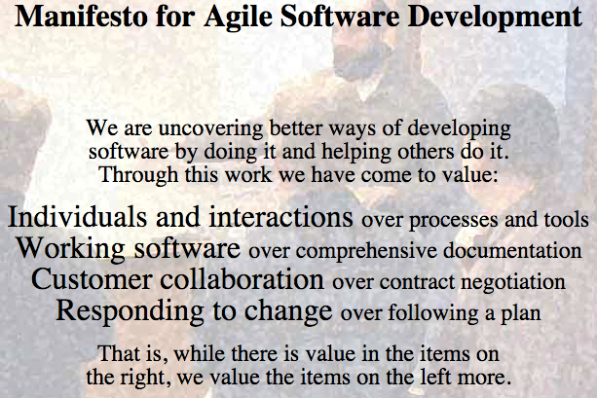
What is Agile Software Development?
Agile is a way of thinking. The canonical description of this thinking is the Agile Manifesto. It defines 4 values and 12 principles for being agile.
Image source: http://agilemanifesto.org/

Slide 3
Why Be Agile?
Being agile helps you achieve success.
Organizational Success
Technical Success
Personal Success
Source: The Art of Agile Development by James Shore

Slide 4
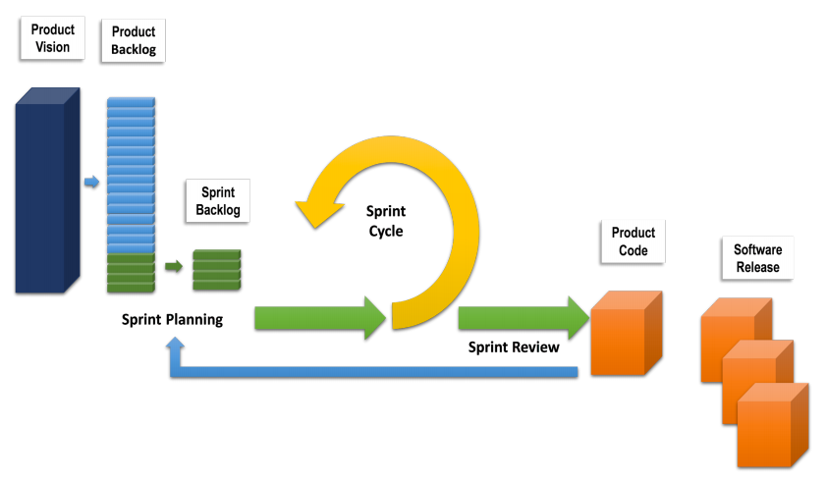
Agile Methods
Agile methodologies express the 12 Agile Manifesto principles in the form of specific practices. XP and Scrum are two of the most popular.
Scrum Methodology

Slide 5
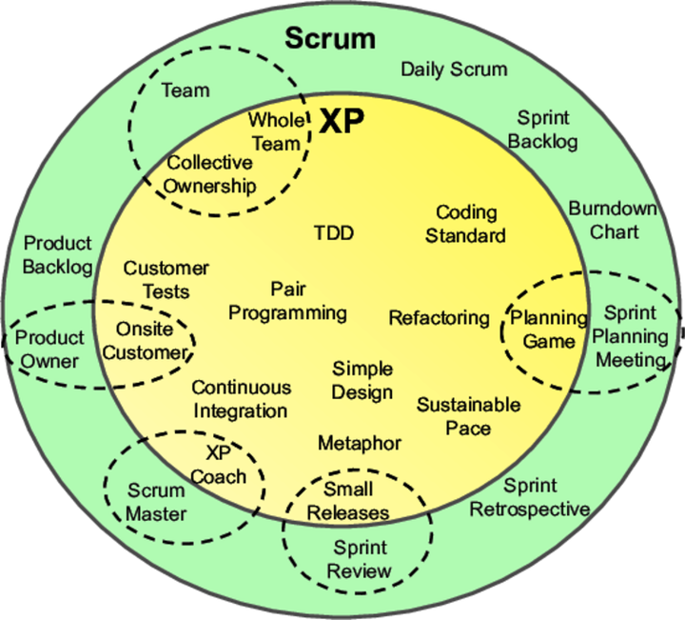
Agile Practices
Source: Lean from the Trenches, by Henrik Kniberg

Slide 6
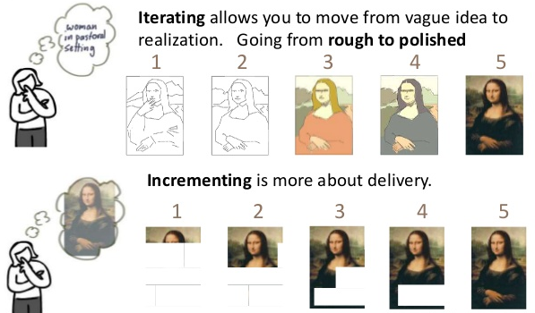
Agile is Both Incremental and Iterative
Source: Jeff Patton

Slide 7
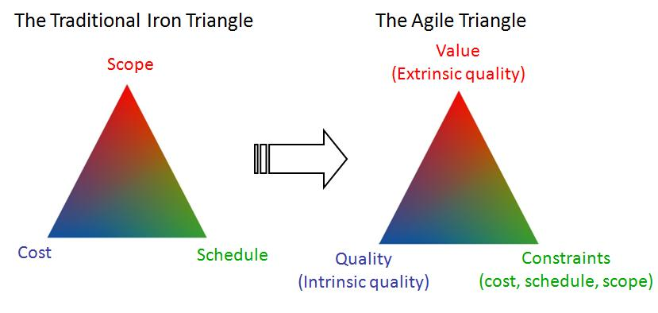
The Agile Triangle
Source: Agile Project Management, by Jim Highsmith

Slide 8
Examples of Agile Acquisitions/Projects within the Federal Government
All 18F software development projects (10+) use agile (and lean) methods
DHS/USCIS uses agile across its portfolio of software development projects
18F Consulting is working with several agencies to help them develop agile approaches to software acquisition, especially with regards to sound technical practices
GSA/18F is also in the process of developing a government-wide contract vehicle that will feature vendors who specialize in agile

Slide 9
Agile Acquisitions 101 The Means Behind the Magic
Presented by Traci Walker and Jonathan Mostowski, Procurement Strike Force Team,
United States Digital Service (USDS)
April 22, 2015

Slide 10

The Road Not Taken
“I shall be telling this with a sigh Somewhere ages and ages hence: Two roads diverged in a wood, and I, I took the one less traveled by, And that has made all the difference.”
-Robert Frost

Slide 11
What is Agile Software Development?
The Government spends $50 Billion dollars on Federal IT contracts but does not receive $50 Billion worth of value. The way the Government uses and buys technology has changed but the workforce, policies & procedures, and how we manage vendors has not.
PEOPLE
There are a limited number of people in the workforce that understand both IT and Procurement which leads to a detrimental skills gap.
PROCESS
The “status quo” approach to large, multiyear, waterfall-based, extended requirement gathering, year-long competitions does not move at the same speed of technology.
PARTNERS
Companies with creative solutions to many of the Government’s tech problems are finding it challenging to do business with the Government due to high barriers to entry, lack of customer facing tools, complex acquisition processes, and communication confusion on how to identify the available opportunities.

Slide 12
The Solution
Transform the Government’s most important citizen facing services to be simple, reliable, and delivered quickly for the appropriate price
Develop institutional capacity so this can be a lasting change

Slide 13

Bottom Line
There is a difference between Agile Development and Agile Contracting
Both traditional contracting and agile contracting have defined requirements
The FAR does not preclude agile contracting but rather provides several options for implementing agility in contracting
There is no single answer to achieving agility however Agile Contracting can be innovated through iterative applications of proven concepts

Slide 14
Manifesto for Agile Software Development
Individuals and interactions over processes and tools
Working software over comprehensive documentation
Customer collaboration over contract negotiation
Responding to change over following a plan
Notes:
Why do we need to have different contracting methods for Agile Software Development Anyway??
The Agile Manifesto specifically highlights that while there is value on the items on the right – you should value the items on the left more.
In doing this, traditional federal contracting methods are not flexible enough to ensure successful implementation of Agile
What do I mean by this?

Slide 15
Keystones for Agile Acquisitions
Individuals and interactions over processes and tools
Understanding the needs of the end-user community sets the priorities of software implementation, not formal requirements driven design/SDLC process
Proper training on agile implementation is a key element for success. Training should include Integrated project teams comprising of all stakeholders
Give the Integrated Contractor/Government Agile Teams the resources needed, inclusive of a flexible contract, and trust they can deliver the required systems
Government Product Owners/CORs must be empowered with decision making abilities and priority setting to meet the vision – not be roadblocked by continual levels of reviews and approvals

Slide 16
Keystones for Agile Acquisitions
Working software over comprehensive documentation
Contractual requirement documents should be designed to drive towards overarching objectives (i.e., program goals, process, interfaces, metrics, and capabilities)
User stories are “just in time” technical requirements and include the required acceptance criteria for released product.
Documentation becomes user stories, design documents, continuous training updates, and testing scripts based on what functionality is actually delivered vs. planned.
Value = frequent and continuous delivery of functional product/software code

Slide 17
Keystones for Agile Acquisitions
Customer collaboration over contract negotiation
Technical requirement/deliverables are not the same as contract requirements/deliverables-
These should be defined separately!
Contracts are defined in terms of cost/price, period of performance, and scope. The deliverables are defined as the “agile process” and capacity so technical deliverables can and will fluctuate
Working software is the ultimate end goal – contracts should not be set up that encourage payment of rework for bad/failed products (i.e. – cost type contracts, no warranties, etc.)
Customer collaboration includes legal, security, 508 compliance, privacy requirements – all can and must be “baked in” to the Government agile development process
Notes:
Work with your legal, privacy, and security officers before you award an Agile Procurement to determine what are the Operational Constraints that will apply to all functionally released under the contract- and include that in the task order and into each Agile Sprint in the Definition of Done.
Make sure Quality Assurance checks off the requirements in each sprint and this will facilitate the ability to release code quickly and continuously instead of waiting for full staged releases that must go through months of security reviews.
Government-caused delay is the biggest challenge to overcome in Agile Software Developments.

Slide 18
Keystones for Agile Acquisitions
Responding to change over following a plan
Users should be receiving the features which provide them the most value – therefore priorities should be in the form of “must have, should have, could have” as priorities changes for the users so should the order of precedence for delivery
Utilize modular contracting methods to reduce the “too big to fail” mentality and encourage flexibility and change –while still meeting FAR competition requirements.
Software Development doesn’t “end” so contracts have to take that into account by purchasing a software development process vs. a delivered software “system”
Dissuade being locked into proprietary solutions by encouraging open source policies and including data rights clauses- in order to protect government property in the case a non-performing integrator contract must be terminated.

Slide 19

Iron Triangles
Both waterfall and agile have defined contract requirements: Cost, Schedule, & Performance
Waterfall Contracts maintain predictability through fixed delivery schedules and system requirements
Agile Contracts maintain flexibility for the purposes of Quality and End User priorities using trade-offs made within the contractual parameters between cost, schedule, and performance

Slide 20
Changing Mindsets
“Once your mindset changes, everything on the outside will change along with it.”
-Steve Maraboli
Waterfall
Individual Labor Categories
Fixed end product
Steady State
New Features = New Cost/Schedule
Driven by WBS/EVM/formal plans
Agile
Teams
Repeated process for functional code
Dev/bugs/enhancements
New features = more teams, longer schedule, or reprioritizations
Driven by product roadmap

Slide 21

Mona Lisa

Slide 22
Agile Contract Deliverable = Repeatable Process
Envisioning/ Estimation
Design
Development
Quality Assurance/Auto Testing/UAT Testing
Training/ Documentation
Functional Code ready for Release
Notes:
While the specific time of the iteration should be left up to the procurement process and solution provided by the vendor – the typical time is 3-5 weeks from Envisioning to Functional Code.
The reason that the code is “ready for release” and not “Released” is the Government/Product owner may need to make decisions about releases based on the vision and priorities: Do you need several sprints to relase a new application? If so, then you may group Sprints together to have a release.
Or maybe you just are working on one off elements in your product back log to reduce your technical debt – these can be released at the end of the sprint and don’t need to wait on a formal “release”
The decision making power for release strategy resides with Government, unless, through your strategic planning- you want to turn this over to the integrator.

Slide 23

Where in the FAR?
FAR 8.4 Federal Supply Schedules
FAR 12 Commercial Contracting
FAR 13.3 Simplified Acquisition Methods
FAR 13.5 Test Program for Certain Commercial Items
FAR 16.202-2 Firm Fixed Price
FAR 16.504 Indefinite Delivery Indefinite Quantity
FAR 37.1 Service Contract
FAR 37.602 Performance Based Service Acquisitions
FAR 39: Acquisition of IT
FAR 27.4 Data Rights (52.227-14)
FAR 52.237-3 Continuity of Services

Slide 24
How to Structure Your Contracts
“If the only tool you have is a hammer, you tend to see every problem as a nail.”
-Abraham Maslow
Single Award
Indefinite Delivery/Indefinite Quantity FAR 16.5
Standard “C” contract
GWAC
Blanket Purchase Agreement
GSA FAR 8.4
BPA FAR 13.3
Set Asides: Flexible intro to learn to apply agile and influence culture
Small Business 9.6
8(a)/HUBZone
Multiple Award
Indefinite Delivery/Indefinite Quantity
GWAC
Blanket Purchase Agreement
GSA FAR 8.4
BPA FAR 13.3

Slide 25
Contract Types, Incentives and Periods of Performance
Types
Fixed Price Per Iteration (Recommended)
Firm Fixed Price
Time & Material (Labor Hour)
Cost Reimbursement (Completion or Term)
Incentives
Performance Based Service Acquisitions FAR 37.6
Quality Assurance Plans
Award Term (Recommended)
Award Fee
Incentive Fee
Periods of Performance
Modular contracting FAR 39
Options
Task Orders
“The aim of an argument or discussion should not be victory, but progress.”
-Joseph Joubert, Pensées, 1842

Slide 26
Evaluation Criteria
Past Performance
The focus should be on how well the company has implemented a solution utilizing their proposed agile process.
Key Personnel
Evaluate Key Personnel based on their demonstrated experience in implementing in an Agile environment. Do not prescribe certifications or qualifications.
Process
Should describe how the vendor will manage, execute, and measure their Agile development to meet end user objectives and maintain quality.

Slide 27
Require a Definition of “Done”
“Definition of Done”: Defines all the steps of the finished increment (i.e. Deliverable) from development till deployment in production
This should a required element in the proposal by the vendor based on their proposed Agile solution, and needs to be part of Evaluation Criteria to ensure it covers all of the required elements.
This is the evaluation criteria that will be used to determine whether individual user stories are complete and can be accepted.
As a team matures, the definition of done should expand and include more elements. Allow for this re-negotiation in the Contract, Award Terms, or via modular contracting methods.
Examples:
All code has been pair programmed or has been code inspected
That coding standards have been met and re-factored where necessary
All 508 Compliance, Security requirements, Legal requirements have been factored into released code

Slide 28

You Get What You Ask For
Request For Proposal
Statement of Objectives
Statement of Work
Only if you are a master of agile implementation (used to implement discrete known functions)
Initial Technical Requirements
Service Dictionary
Backlog
Product Road Map
Epics/Themes
Proposal Submission
Performance Work Statement
Agile Development Management Plan
Quality Assurance Surveillance Plan
Unpriced Basis of Estimate

Slide 29
Performance Management
Be careful what you measure, because that is what you will get
Velocity/Throughput
Track the trend. As the trend stabilizes, teams can forecast their product backlog. Release planning also becomes easier for the product owner.
Defect Density
The number of bugs discovered during a sprint. An increasing number of bugs sprint-over-sprint could mean that the team is taking on too much work. A downward trend could point to changes in the definition of done improving quality.
Customer Satisfaction
The goal is measure satisfaction over time and to also address negative feedback quickly.
Team Satisfaction
Use the “5 Why’s” and other techniques to get to the root cause of whichever way the trend is going.
Value Per Iteration
This metric measures how much value the scrum team is delivering back to the customer/business/organization. A downward trend in this metric could indicate that lower value features are being implemented and that it is time to stop development on the product.

Slide 30

In a Nutshell
Change the way you define requirements
Use Statement of Objectives
Choose appropriate vehicle
Work closely with stakeholders
Monitor effectively
“There will be a time when you believe everything is finished. That will be the beginning. ”
-Louis L'Amour

Slide 31
Agile Acquisitions 101 The Means Behind the Magic
Presented by Mark Naggar, Project Manager, HHS Buyers Club
April 22, 2015

Slide 32
HHS Buyers Club
Problem
IT projects >$10 million either challenged or failed
According to the 2013 Chaos Manifesto from the Standish Group
Solution
Reengineer acquisition processes to seek better value and outcome for contracted services.
Utilize innovative acquisition methods
Incentivizing operational and cultural change
Evaluate vendor capabilities more than writing skills

Slide 33
HHS Buyers Club – Goals/Objectives
Testing innovative acquisition methodologies
Development and sharing of Use Cases based on the results for everyone to benefit
Development of newer, easier, more effective acquisition models and processes
Markets always change (i.e. CrowdSourcing)
Engagement of all key stakeholders with effective education/outreach
Acquisition models/processes should work for all

Slide 34
HHS Buyers Club – Approach to Leveraging Resources
HHS Acquisition Decision Diagram (New)
HHS Strategy and Execution Plan
OpDiv Buyers Club Components
Identifying and sharing any:
Common barriers, Ideas, and solutions,
Best Practices, Research, Templates, & Guidance
Pitfalls, Lessons Learned, Failures, and/or
Opportunities for Collaboration across federal government

Slide 35
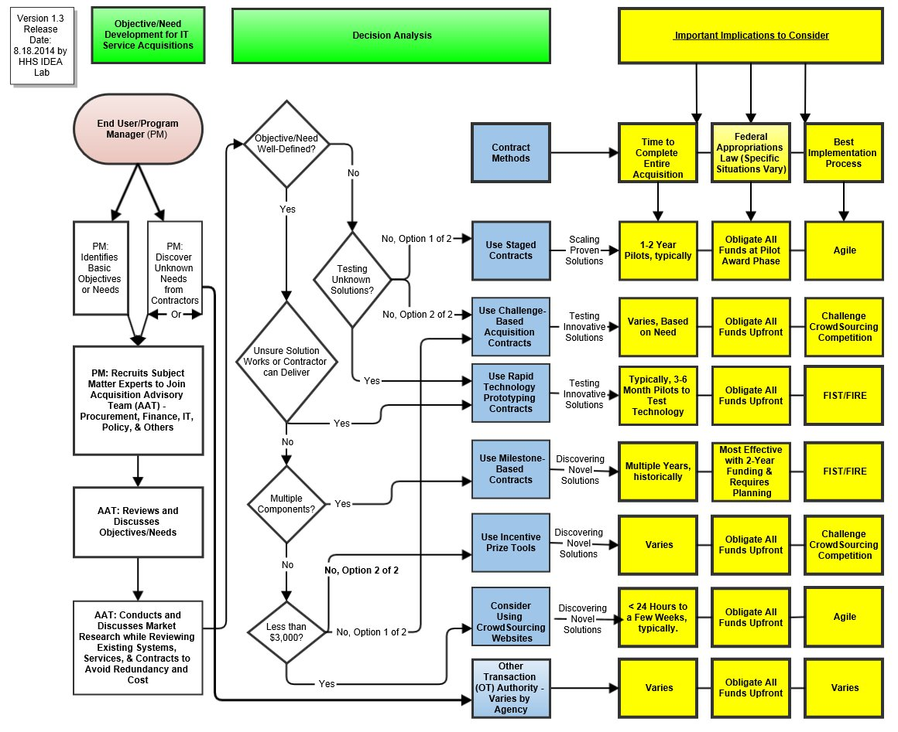
Acquisition Decision Diagram

Slide 36
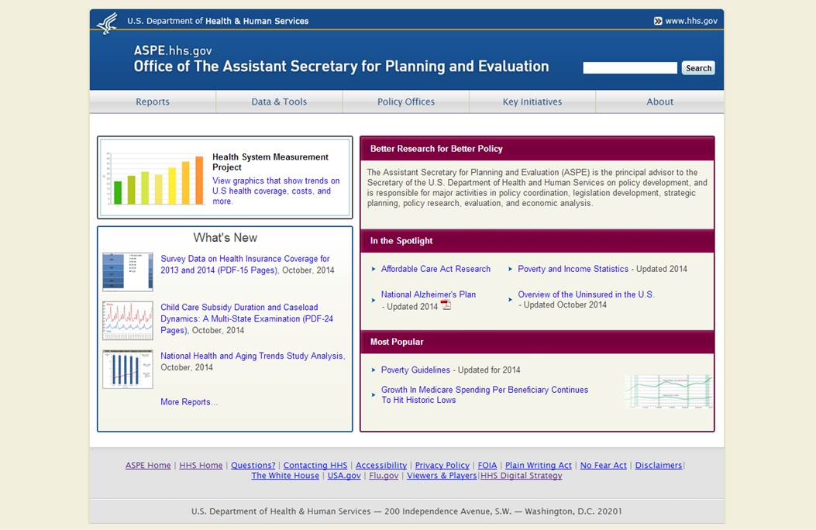
Current ASPE Homepage

Slide 37
Keeping the Train on the Track
ASPE Web Content Management System
Small Business Set-Aside; Time & Materials Contract
Two-Stage Down-Select
Stage One: Short Concept Paper & Cost Proposal
24 proposals with Two (2) week deadline
Evaluated 8 –page Concept Paper and Cost Proposal
Stage Two: Proof of Concept Prototype Focus
Awarded Five (5) purchase orders for $10,000 each
Received 5 prototypes, Cost Proposals, and Performance Work Statements

Slide 38
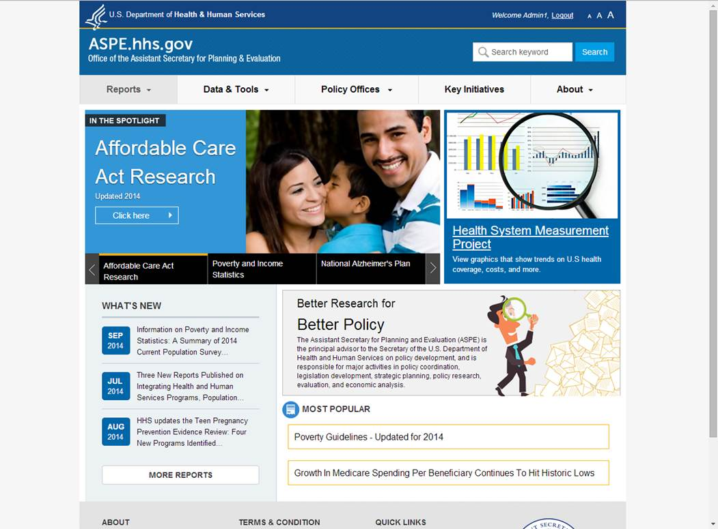
Prototype 1

Slide 39
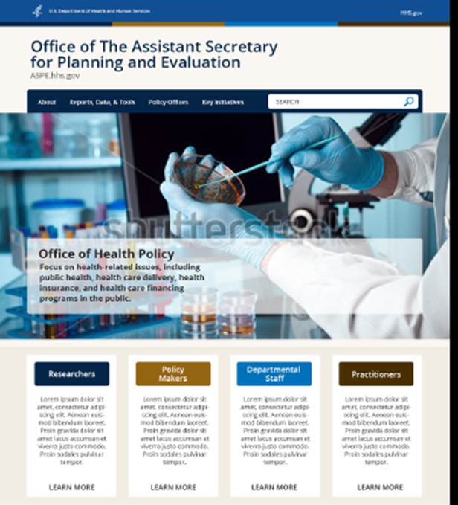
Prototype 2

Slide 40
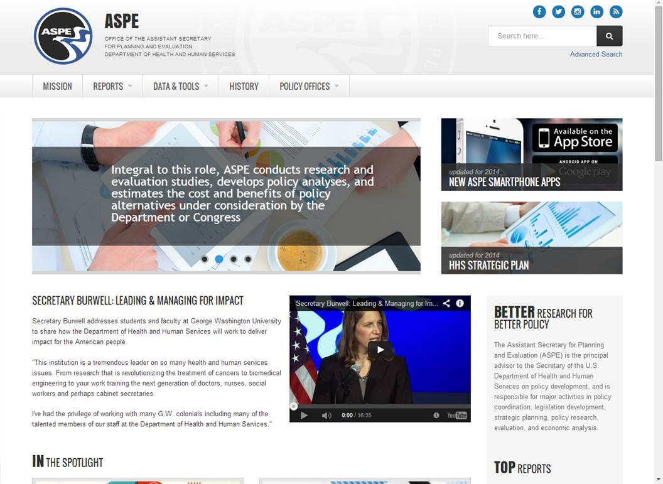
Prototype 3 and Winner

Slide 41
Use Case & Stakeholder Feedback
Advantages of this approach and why it worked?
Staged Solicitation minimizes burden on offerors
Concept paper focused on agile methodology and approach to objectives
Prototype-driven evaluation allows:
Offerors to showcase their capabilities;
Program End Users to evaluate work product and coding before award
Mitigates failure risk and increases likelihood of success
Show (prototype) and Tell (text-based) proposals are better than just “Tell”

Slide 42
Use Case & Stakeholder Feedback
Stakeholder Feedback
All stakeholders (including Offerors):
Valued this streamlined approach
Preferred the prototype-driven approach with staged solicitation
Would like oral presentations to be included moving forward

Slide 43
The Agile Implementation Process
Communication and Ongoing End User Feedback
Contractor and End User communicate daily
Contractor delivers in two-week sprints
Allows End User to closely monitor and prioritize work
First time this End User’s division has used agile methods
They’re beyond thrilled with the results even though it requires more effort on their part. The result is a much better value than traditional waterfall method
Truly assists End User and Contractor partner together to achieve vision and objectives

Slide 44
The Agile Implementation Process
Communication and Ongoing End User Feedback
The Agile Technology Stack (modern IT service delivery tools)
Enables consistent interaction and collaboration
Desktop sharing and Conference Calls are only basics
Mostly free, online tools used on this and other projects
Scrum planning & monitoring tool used for user stories, backlog, task monitoring, and priority adjustments
Enterprise file sharing (and documentation repository)
Version control system; Card sorting tool;
Mind mapping tool for taxonomy generation and shared mind map
Sharing and online editing of the high-level project planning

Slide 45
What’s Next?
Engage with each OpDiv to help them succeed in their acquisition of IT services
Develop Buyers Club SME’s/Working Groups throughout each OpDiv
Because each OpDiv is unique and different
Share within, throughout HHS, and throughout federal
Gather continuous feedback to improve
Including on the Acquisition Decision Diagram

